Slide 1
Iberoamerican Academy of Management Business Meeting
Virtual, August 2020

Slide 2
Mission, Goals, and Initiatives
Mission: To foster the general advancement of knowledge in the theory and practice of management among Iberoamerican scholars and/or those academics interested in Iberoamerican issues.
Iberoamerica is defined broadly and includes Latino populations in North America, Latin America and Caribbean, and the Iberian peninsula (i.e., Spain and Portugal).
Strategic goals (2016-2020): financial stability, operational efficiency, visibility, and expansion.

Slide 3
Executive Committee Members
Len J. Treviño, (President) Florida Atlantic University (USA)
Jose Ernesto Amorós Espinosa (VP, Editor Management Research), EGADE Business School (Mexico)
Monica Franco-Santos (VP), Cranfield School of Management (UK)
Maria Fernanda Wagstaff (VP and Treasurer), University of Texas at El Paso (USA)
Martin Larraza Kintana (VP), Universidad Pública de Navarra (Spain)
Luiz F. Mesquita (VP), Arizona State U. (USA)
Ronaldo Parente (VP), Florida International University (USA)
Carlos Alsua (Secretary, PDW Program Chair), Arizona State University
Jose Luis Rivas Pérez (VP), ITAM (Mexico)
Maria Jose Tonelli (VP), Fundacion Getulio Vargas, Brazil
Erica Salvaj, (VP) Universidad del Desarrollo, Chile
Desiree Pacheco (VP), Portland State University, (USA)
Jorge Gonzalez (VP), University of Texas at El Paso, (USA)
Juan Velez-Ocampo (VP), University of Antioquia, Medellín, Colombia
Past Presidents: Carolina Gomez Florida International U. (USA) Herman Aguinis (George Washington University, USA), Julio de Castro (IE, Spain) and Luis Gomez-Mejia (Arizona State University, USA)

Slide 4
Agenda
State of the Association
IAM Website (Monica Franco)
Social Media
Research Consortium Announcement (Update)
Report on budget and finances (Maria Fernanda Wagstaff)
Report on AOM 2020 PDW (Carlos Alsua)
Report on Management Research (Jose Ernesto Amorós Espinosa)
Elections
Additional items and suggestions

Slide 5
State of the Association
2019 Conference hosted by Universidad de La Sabana, Bogota (Guido Castro/Hilda Arango de Ortega)
122 Papers submitted; Doctoral Consortium, AMD Paper Development Workshop..
2021 IAM conference committee: Len Trevino (Chair), Jose Ernesto Amoros, Erica Salvaj, Julio de Castro ….
2021 Conference Host/Place to be announced soon!!
Listserv has been replaced with AOM Connect platform… IAM members to add themselves to the AOM connect platform
2-year membership fee institutionalized but has created some confusion around conference fee.
Website migration in process.
New Research Consortium being created

Slide 6
IAM Website
Adobe platform is ending (June 2021)
New president will need to form a committee to find a replacement
Adobe platform was inexpensive (less than $600 a year after initial design of $4500) but required someone to actively manage website
Allowed for secure payment of membership dues and conference registration (when needed)
Included membership reminders
Members could sign in to a members only section where the journal link was available
Under current platform, conference host could have our web designer upload conference page ($800)

Slide 7
Research Consortium
FIU has provided a small amount of seed money to help start a research consortium to help the IAM members collaborate on research
Goal: to increase collaboration, publication among IAM members
The purpose of the research project is to develop EMIC scales of the employee engagement that capture the behavioral ways in which the same construct is expressed across different cultures.
There will be a set of rules that all researchers will have to abide by. These rules will include:
Rules of participation
Use of data (who and authorship)
Please contact either Juan Sanchez or Carolina Gomez for potential inclusion in the research consortium

Slide 8
Budget & Finance
Maria Fernanda Wagstaff
Contract with Emerald continues at a reduced fee based on access to journal via website vs sending out journals.
Conference surplus donated by FAU.
We have approximately $39,642.88* (May 31 statement) in the bank after taking into account expenses for this year:
Social Hour/Reception taking place today ($2500)
Upcoming expenses: web maintenance $700
Management Research fee is $4500 this year
*Will need to cover 2 years of expenses, and webpage migration/transition

Slide 9
AOM 2019 PDW
Carlos Alsua, Program Chair
2 IAM PDWs, 19 presenters
Lagarde’s Endorsement: Gender Differences in Managing Organizational Crises & Grand Challenges
Decoding Female Entrepreneurship in Latin America
IAM is also co-sponsoring 2 PDW sessions with other divisions, 12 presenters
Entrepreneurial Migrants from and in Emerging Economies
The Extended Family as an Entrepreneurial Asset in Collectivist Cultures

Slide 10
Management Research
Jose Ernesto Amorós Espinosa

Slide 11
Management Research
Management Research continues growing
Number of users (see next slide)
Now ranked by: ABS academic journals list; Scopus (H-index=15; SRJ=0.35 (Q2)) and Thomson Reuters Emerging Sources Citation Index (CiteScore 2018: 0.85)
Is now ranked A3 on QUALIS Brasil
Management Research is indexed, abstracted and ranked by
ABI INFORM; AIDEA 2015-2016 Journal Rating; Cabell's Directories of Publishing Opportunities in Management; EBSCOhost; Excellence in Research for Australia (ERA); QUALIS; Latindex (Catalog and Directory); Summon; ProQuest; ReadCube Discover; ABS; Scopus; Thomson Reuters Emerging Sources Citation Index; TOC Premier
Recently applied to the new edition of the ERA list (supported by the University of Queensland and Prof. Manuel Becerra)

Slide 12
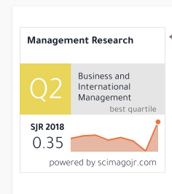
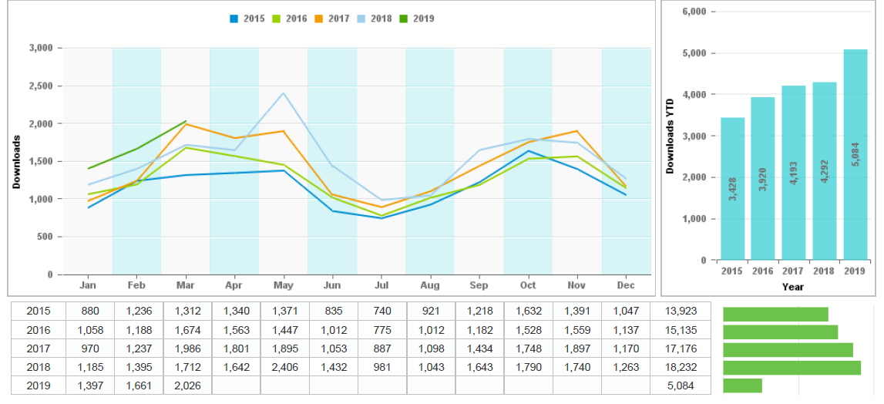
Management Research
Latest usage data

Slide 13
Management Research
2019 Emerald Literati Award Winners
Winner
Volume 16 number 1
The two sides of CEO pay injustice
Herman Aguinis, Geoffrey P. Martin, Luis R. Gomez-Mejia, Ernest H. O’Boyle, Jr., Harry Joo
Highly commended
Volume 16 number 2
Ambidexterity strategies in illegitimate institutional contexts: the role of informal institutions
Jacobo Ramirez, Claudia Vélez-Zapata, Sergio Madero
Winner of the IAM 2018 Conference Best Paper Award
Outstanding reviewer
Valentina Lazzarotti

Slide 14
Management Research
Goals - Challenges
Attract more submissions still our major challenge/goal.
Number of submissions still relatively low
About half of new submissions are desk rejected
Being in Scopus and Thomson Reuters may help, but need to keep pushing
Continue improving our position (also in Latindex and QUALIS)
Necessary to be on major indexes and ranks (visibility): JCR comes next
Continue publishing special issues and papers
Submit your proposals for special issues to martin.larraza@unavarra.es
Submit your research papers: https://mc.manuscriptcentral.com/mrjiam
Spread the word among your networks
Visit the journal’s web page http://www.emeraldinsight.com/journal/mrjiam

Slide 15
AOM 2020 PDW Program
Carlos Alsua, McGuire Center for Entrepreneurship, Eller School of Management, University of Arizona

Slide 16
Election
Process
Nominating Committee:
Carolina Gomez, Chair and IAM President
Herman Aguinis, IAM Immediate Past President
Julio de Castro, IAM Past President
Erica Salvaj, IAM Vice President
Len Treviño, IAM Vice President
There is a maximum of three 3-year consecutive terms for VPs and two 3-year consecutive terms for the President
Self-nominations solicited using IBERO and listservs for several AOM divisions (e.g., BPS, HR, RM, OB, ENTP, IM)

Slide 17
Elections
President
Len Trevino, FAU (USA)
VP Renewals:
Jose Ernesto Amorós Espinosa (VP), Universidad del Desarrollo (Chile)
Monica Franco (VP), Cranfield (UK)
Jose Luis Rivas Pérez (VP), ITAM (Mexico)
Erica Salvaj, (VP) Universidad del Desarrollo, Chile

Slide 18
Election for President
Dr. Len Treviño is the SBA Communications Distinguished Professor in International Business, Professor of Management, and Director of International Business Programs at Florida Atlantic University. He received his Ph.D. and M.B.A. from Indiana University and his B.B.A. magna cum laude from the University of Notre Dame. His research focuses on international business theory, the multinational enterprise, and organizational behavior. His scholarship has appeared in leading management and international business journals, including Journal of International Business Studies, Journal of Management, Journal of World Business, Academy of Management Learning and Education, International Business Review, and Management International Review, among many others.Dr. Treviño is Associate Editor at Cross Cultural and Strategic Management and serves on the Editorial Review Board of Journal of World Business. Dr. Treviño has worked and consulted with United Nations Conference on Trade and Development (UNCTAD), Leo Burnett, Whirlpool Corporation, Burson-Marsteller, Monsanto, Dow Brands and Eli Lilly, among others. He speaks Spanish, French and Russian

Slide 19
Renewals
Jose Ernesto Amoros is Director of Doctoral programs and Coleader of the strategic research group in entrepreneurship, EGADE Business School, Tecnológico de Monterrey Mexico. He has written more than 40 academic articles published in leading entrepreneurship journals. He is also co-author of more than 30 monographs on entrepreneurial dynamics, some of them in cooperation with important institutions such as the World Economic Forum. He´s visiting professor in several Latin American and European universities. He has been a member of the Board of Directors of the Global Entrepreneurship Monitor, GEM project and is part of the research committee. In his work within the GEM project, he has participated in the evaluation of public policies pro-entrepreneurship in different countries.

Slide 20
Renewals
Dr Monica Franco-Santos is an Associate Professor in the Centre for Organizational Performance, Cranfield School of Management (UK).
Monica’s research, teaching and consultancy focuses on organizational governance. In particular, Monica is interested in understanding the behaviour and consequences of performance measurement and management systems. Her work takes place in private, public and third sector organisations.
Monica has more than 50 publications in high-impact academic journals, books and practitioner outlets (for a detail list of her publications. At Cranfield School of Management she teaches in the PhD, DBA, MBA and MSc programmes as well as in various Executive Education programmes with individual organizations. Monica has been a visiting lecturer in ESADE Business School (Barcelona), Stockholm School of Economics (Riga) and Universidad Carlos III (Madrid). She is also an occasional lecturer and speaker in a number of other European academic institutions.
Prior to joining Cranfield University, Monica was a consultant working for Watson Wyatt Worldwide (now Willis Towers Watson).

Slide 21
Renewals
Erica Salvaj is Associate Professor of General Management and Strategy at Universidad del Desarrollo (UDD), Chile and Visiting Scholar at Universidad Torcuato Di Tella, Argentina. Her primary fields of research are strategy, leadership, organizational change, social networks, internationa business and business history. She completed his Ph.D. in Business Administration at IESE Business School, was GCEE Fellow at Babson College and has received fellowships and research grants from the Comisión Nacional de Investigación Científica y Tecnológica de Chile (CONICYT) and Agencia de Promoción Científica y Tecnológica de Argentina (CONICET). Recently she has been awarded with the fellowship “Alfred Chandler” from Harvard Business School and the Australia-APEC Women in Research Fellowship. Her publications have appeared in leading journals including Global Strategy Journal, Journal of Business Research, Harvard Business Review, Business History, Business History Review, Corporate Governance: an International Review and Harvard Deusto Business Review among others.

Slide 22
Renewals
Jose Luis Rivas is a professor and researcher at ITAM Business School. He currently teaches leadership, global strategy both at the undergraduate and graduate levels. He holds a PhD in management from IE Business School in Spain, an MBA from the Kellogg School of Management and a Bachelor in Business Administration. He is also a graduate from the International Teachers program at the Bocconi edition in Milan. His research interests focus on boards of directors, top management teams (TMTs) and initial public offerings (IPOs). He is the author of a forthcoming book on corporate governance in Mexico and has published articles in journals such as “Journal of Management Studies”, “International Business Review” and “Cross Cultural and Strategic Management”. Jose also serves as editorial board member in Corporate Governance: an International Review and was designated as the country expert for Mexico at the International Corporate Governance Society.

Slide 23
Feel free to contact Executive Committee members with additional ideas and suggestions Join us for our wonderful reception Thank You, Gracias, Obrigado!

